Slide 1
Add 3D objects to your slides in powerpoint

Slide 2
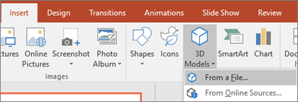
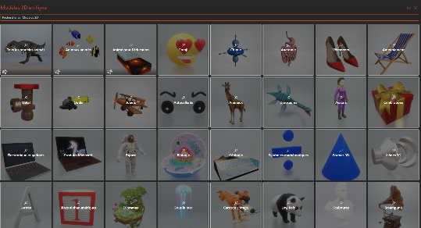
Start by adding your first 3D object
1
You can import 3D objects that you have on your pc or that you downloaded online. Nice online sources include sites like sketchfab.com, cgtrader.com & turbosquid.com (PowerPoint can handle *.obj,*,3mf, *.ply,*.stl,*.glb files). You can also play around with AI to request text to model via luma AI.
Don’t want the hassle to go look too far, when selecting « From Online Sources », Powerpoint presents you with a database of 3D objects ready to use.
Go to insert, 3D models and select where you want to get your model from.
2
If you select the from online source, you’ll be presented with this library. Please note some of them have this icon . These models are animated.

Slide 3
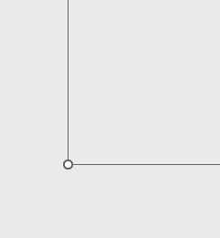
Control how it is positioned
When you click the 3D object, this gizmo appears to the center. Click and hold while moving with your mouse to see the perspective change
You can also rotate the model by rotating the bounding box. This will not impact the camera angle, rather it will just rotate everything relative to the bounding box.
Use the bounding box dots to increase the size of the model on your slide, as you would for any other object.

Slide 4
Change the camera presets
When clicking on your model you will see a new menu highlighted in the ribbon bar after the Help menu.
In this menu, you will be presented with a whole set of controls for your object. One of them are the default camera presets, allowing you to select quickly the point of view you want.

Slide 5
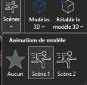
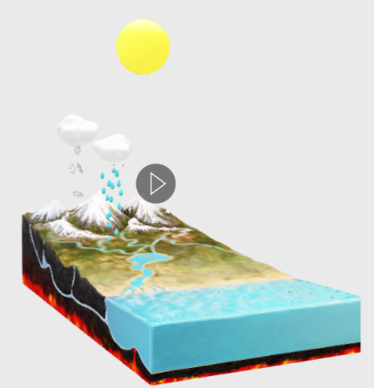
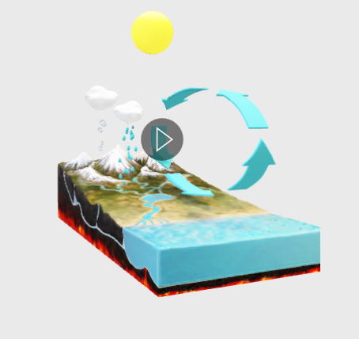
Look for extra 3d animations within the model
Some models may contain multiple type of animations; you can select them if appliccable via the « scenes » menu.

Slide 6
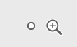
Create a highlighted area by zooming
In the 3D model ribbon menu, you will find the option panoramic & zoom.
When clicking this, a magnifying glass appears to the right of the model, this allows you to zoom to a certain part. You can use your mouse to pan the camera to align the view where you want it.

Slide 7
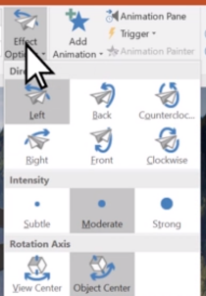
Add an animation to your model
When your 3D object is selected you will discover new animation options specifically destined to 3D objects to make them appear, go away or giving them an animation throughout your slide. Arrive or Leave, Turntable and Swing, Jump & Turn.
The default settings of those animations can be a bit harsh depending on what type of presentation you are going for. You have the options to adjust the effects within the button ‘effect options’.

Slide 8
Combine animations to keep the model moving
+
+
+
Arrive
turntable
=

Slide 9
Or morph the position of your 3D object from 1 slide to another
Duplicate the slide with your 3D object
In the duplicated slide you add a transition via the menu transitions and select MORPH
Change the position of your model, the size, the scale, the angle,…
Hit presentation mode and see how the 3D model moves from one location to another

Slide 10
That’s cool but…
Embedding 3D in PowerPoint directly has its limitations. While you can control a lot, not every aspect of the model is manageable, and reaching a specific result might become tedious. Additionally, as observed in this file, 3D models are heavy and can weigh down your PowerPoint presentation, making it inconvenient for easy transfer via email.
Another critical aspect is the fidelity of the object. PowerPoint lacks the capability to preserve textures as they were originally designed; for example, transparency does not translate accurately.
For certain use cases, embedding 3D models in PowerPoint is worth considering. However, for others, exploring alternatives such as playing with rendered images, using MP4 files, or embedding an interactive web app into your presentation may offer a more efficient solution.

Slide 11
Where powerpoints hits a limit, there are other options
Get in touch to discover what other options we can use to craft the most epic presentation by far using 3d.
https://taleshapes.com/contact

Slide 12
THANK YOU
Talk soon!

